Slide 1
Omiga .Net port
Infrastructure Breakdown
July 2007

Slide 2
Project Overview
 Artinsoft requirements
Infrastructure Breakdown
Infrastructure Overview
BTS Service & Support

Slide 3
Artinsoft Requirements
➔ No access required to Vertex VM Desktops or Vertex test environments

Slide 4
Infrastructure Breakdown
 Network
Citrix
ESX
SQL
Loadtest Environment
Mortgages d\top refresh
VOIP

Slide 5
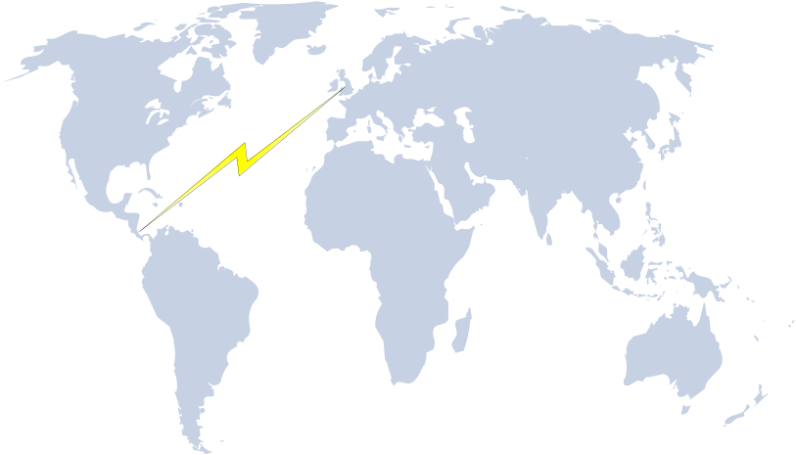

Infrastructure Breakdown - Network
Connectivity
VPN is currently the preferred option to establish a
Communication link between Cost Rica and Vertex
Financial Services
➔VFS Internet breakout system is located in Watford (UK)
Bandwidth = 100MB
AiS Would be required to connect to the Citrix farm via Citrix Network neighbourhood (Configuration details TBC)
Further investigation is required to confirm that the establishment of a VPN is the preferred method
Full User acceptance testing is required prior to Project sign-off
Resiliency options for this link is to be confirmed
AiS to confirm their Internet Bandwidth
FTP Availability
VFS can provide a FTP Service account to AIS
Currently this service is not a secure encrypted site
For secure FTP for file transfer a 3rd party application would have to be purchased
External IP’s
External IP addresses can be provided to the WEB\APP servers if requested

Slide 6

Infrastructure Breakdown - Citrix
The VFS Citrix Farm consists of 15 x Servers with applications load balanced across the farm
The current stand server for this farm = BL25p G2 pClass server AMD Opteron 2214
http://h18000.www1.hp.com/products/quickspecs/12569_div/12569_div.html
Technical Specification:-
➔ Processor – 2x 1MB Dual Core (2.2Ghz)
Memory – 4GB (PC2-5300 Registered DDR2 (667 MHz) memory)
Network – 2 x NC373i Multifunction Gigabit Server Adapters
Proposed Published Citrix Applications
➔ RDP
➔ Office
➔ Adobe Acrobat
➔ Live Communicator
➔ Outlook
It is assumed that up to 3 VFSD developers will require Citrix Access to the VFS network from Costa Rica

Slide 7

Infrastructure Breakdown - ESX
The ESX farm will consist of a HP DL585 G2.
http://h10010.www1.hp.com/wwpc/us/en/sm/WF05a/15351-15351-3328412-241644-3328422-3219717.html
The version of ESX in use is ESX 2.5.2 (V3 is currently in R&D and may be implemented by to the go-live date of the project)
Indicative number of VM images = 40
Users will connect to the VM desktop via RDP published within Citrix
Technical Specification:-
➔ Processor – 4 x 2.4Ghz 1MB Dual Core
➔ Memory – 32GB (DDR2 PC5300 Registered ECC SDRAM DIMMS)
Network – 2 x NC373i Multifunction Gigabit Server Adapters
    2 x NC360T PCI Express Dual Port Gigabit Server Adapter
System Test (Web\App server):-
⇨ Quantity - 3
⇨ OS – W2003 Server Standard SP1
⇨ Memory – 1GB
⇨ Domain – Developer Domain

Slide 8
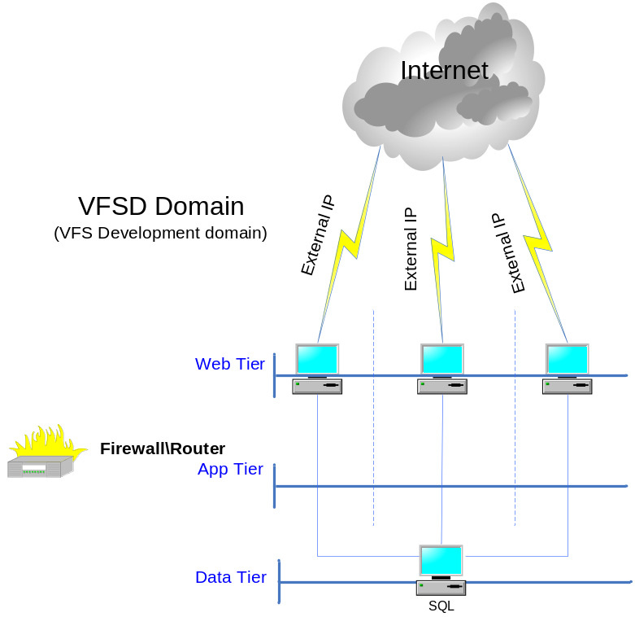
Infrastructure Breakdown – System Test Environment
There will be 3 x System test environments hosted within the Development domain with VFS.
Each Environment will consist of 1 x ESX VM Server acting as a Omiga Web\App system
These systems will be hosted on the Web Tier with the option of an External IP address
Each server will have controlled access via a firewall to a dedicated SQL Server

Slide 9
Infrastructure Breakdown – SQL Environment
SQL Environment
There is a requirement for the System Test environments to talk to a SQL Server.
This SQL Server will be located with the Data Tier within the VFS Development domain
The SQL Server will be supported by a SAN infrastructure (Storage to be provided by a
EVA8000 Storage device – Raid 5)
Logs \ Data \ Backup will be located on individual disks
  ➔ Technical Detail
  Make\Model - Proliant BL25p G2 pClass Server AMD Operron 2214
  Processor - 2 x 1MB Dual Core (2.2GHz)
  Memory - TBC
  OS - W2003 Standard
  SQL Version - SQL2005 Standard
  ➔ SQL Level of Access
  Level of access will be dictated by the Mortgages business unit and
  not be restricted by any Corporate policy.

Slide 10
Infrastructure Breakdown – Build PC
 Build PC
Vertex Financial Services will require the use of a 1 x build PC
  Make\Model - HP Compaq dc7700 Small Form Factor PC – Specifications
  OS - XP SP2
  Memory - 1GB
  http://h10010.www1.hp.com/wwpc/uk/en/sm/WF06a/35123-968421-968421-968421-12798986-12799038.html
➔ AiS will require a build desktop locally
Applications Required
Windows XP Professional Service Pack 2.
Visual Studio 2005 Service Pack 1.
Source Safe client.
FinalBuilder 5
InstallShield

Slide 11

Infrastructure Breakdown – Mortgages Desktop Refresh
There may be a requirement for the existing Mortgages developers to undergo a desktop refresh
in order to support the required applications.
The number of upgrade required is currently unknown.
  Make\Model - HP Compaq dc7700 Small Form Factor PC – Specifications
  OS - XP SP2
  Memory - 1GB
  http://h10010.www1.hp.com/wwpc/uk/en/sm/WF06a/35123-968421-968421-968421-12798986-12799038.html
Application Requirement:
Windows XP Professional Service Pack 2.
Visual Studio 2003 Service Pack 1.
Visual Studio 2005 Service Pack 1;
Note: Some existing developer PC hardware may need upgrading to support Visual Studio 2005;
also some developers may need licenses for Visual Studio 2005.
.Net Framework 1.0 Service Pack 3.
SQL Server 2000 client tools.
SQL Server 2005 client.
ClearQuest client.
ClearCase client.
Microsoft Office 2003.
Adobe Acrobat

Slide 12
Infrastructure Breakdown – VOIP
Vertex have a dedicated Telephony team that could potential provide a Telephony
Solution in order to reduce any potential International communication cost
VOIP Options are still to be reviewed and discussed
Live Communicator is being recommended as the initial immediate form of
Communication between the teams.
The Live Communicator application will be published via the VFS Citrix Farm

Slide 13
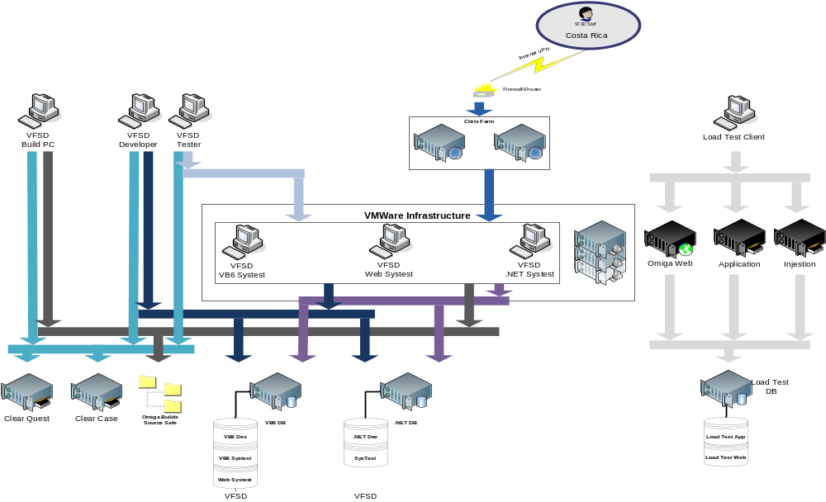
Infrastructure Overview

Slide 14
BTS Service & Support
Hours of Support
  08:00hrs – 18:00hrs GMT
Out of Hours Support
  Currently an out of hours support structure is in place to support all
  priority 1 and priority 2 calls.
Customer Service Center
  ⇨The service desk is manned 08:00hrs – 18:00hrs to support
  ⇨All users issues \ requests should be raised via the CSC
Incident Management
  ⇨All Major incidents are passed to the Incident Manager for control and coordination
Change Control
  ⇨All Infrastructure changes must be compliant with the current VFS Change control process
➔A detailed Service and Support document will be provided to both AiS and Mortgages
prior to Go-Live
➔During the project implementation support procedures will be reviewed to ensure that they
provide the necessary support and delivery of service required by both AiS and Mortgages

